Slide 1
Cinemachine Follow Camera
Name : Vishal Kumar
(20MCA10001)

Slide 2
What Is Cinemachine?
Cinemachine is a powerful package that lets us:
manage multiple cameras in our scene
Easily create rules for our cameras

Slide 3




Main Camera
Cinemachine Brain
Virtual Camera
1
2
3

Slide 4
Add A Follow Camera
Install Cinemachine from Package Manager
Add Cinemachine Brain component to camera
Add Virtual Camera
Rename Virtual Camera
Point the Virtual Camera to follow the player
Tune distance

Slide 5
Steps

Slide 6
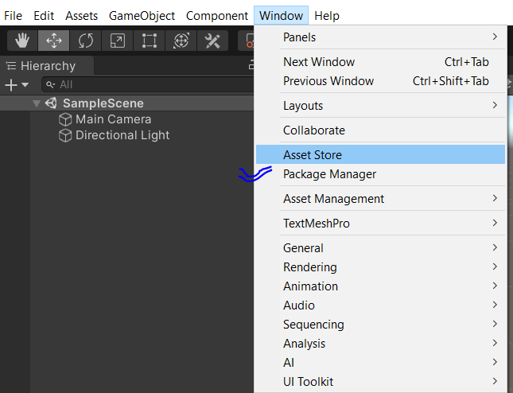
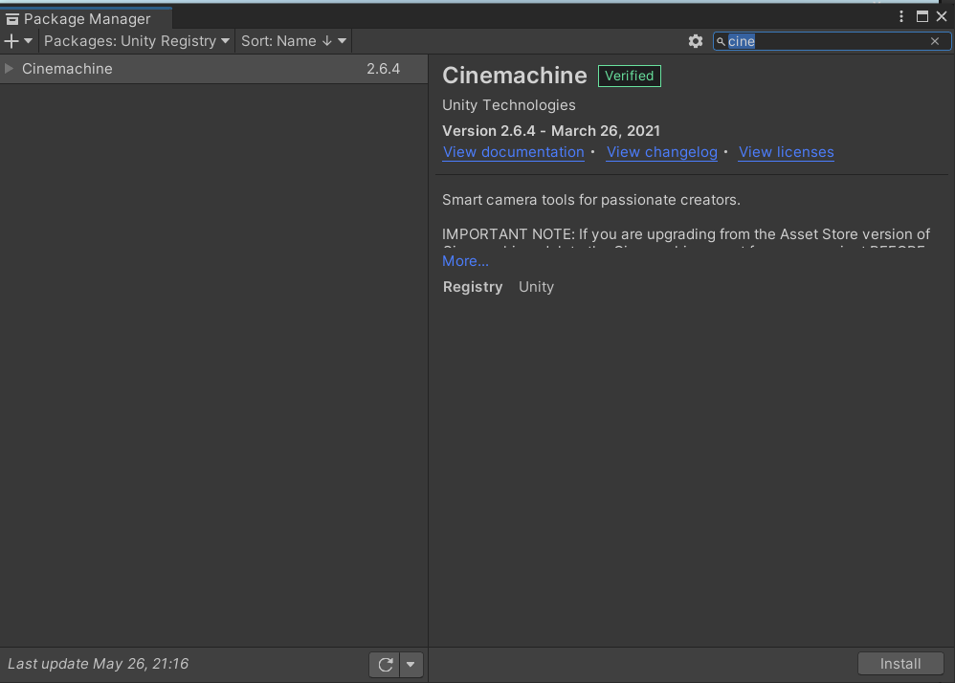
Install Cinemachine from Package Manager
Search for Cinemachine in package manager

Slide 7
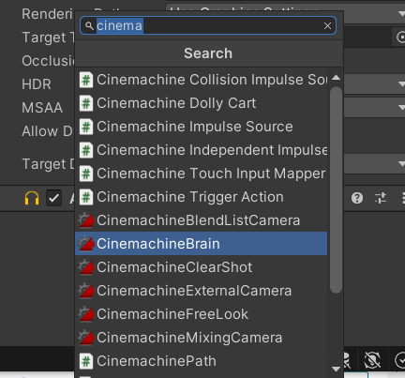
Add Cinemachine Brain component to camera
click on Main camera=> components: and search for cinemachine=>click on cinemachine brain.

Slide 8
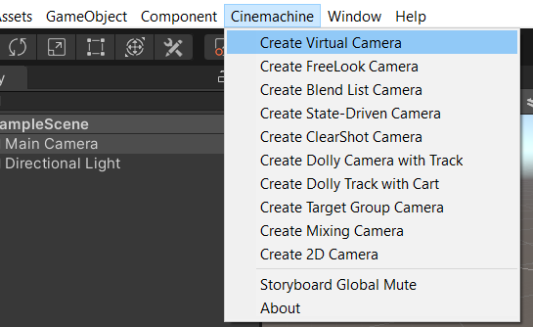
Add Virtual Camera and rename it

Slide 9
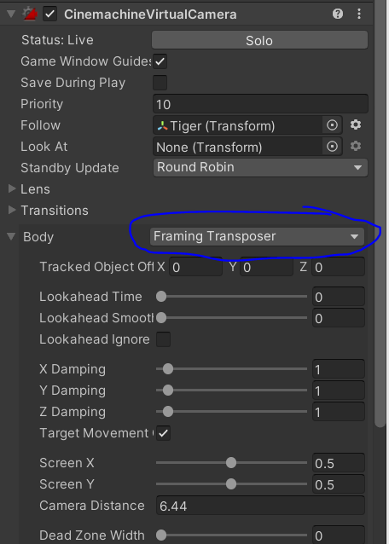
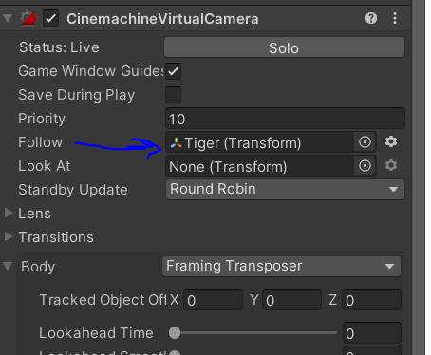
Point the Virtual Camera to follow the player
In Cinemachine Vitual Camera change body type to framing transposer
Then add your player under Cinemachine Vitual Camera follow=>

Slide 10
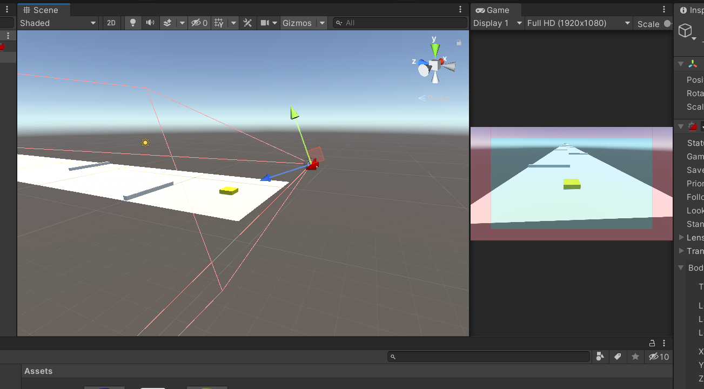
Tune distance
Tune the virtual camera accordingly

